Slide 1


“Electronics E-Commerce Store”
INSTITUTE FOR ADVANCED COMPUTING AND SOFTWARE DEVELOPMENT(IACSD),AKURDI.
Presented by-
1057_Vinayak Gawari
1223_Abhijeetsingh Thakur
Mr. Prashant Karhale
Centre Coordinator
Mr. Kashinath Patil
Project Guide

Slide 2
Contents :-
Introduction
Technologies used
Modules
Proposed System
System Architecture
System Design
E-R Diagram
Use Case Diagram
Test Screens
Conclusion and Future Scope.
References

Slide 3
Introduction
The main application of the project is to provide a platform for the
customers as well as buyers for purchasing and buying their products online.
The Seller can add or delete the products as per the need.
The Customer can add the products in the cart and order them.
This online application provides an ease for the customers to buy the things online.

Slide 4
Technologies Used
Backend :
Spring Boot
REST API
Spring Data JPA
Frontend :
Node.JS
REACT Framework
CSS
HTML
Bootstrap 5

Slide 5
Modules
Customer Module
Can register on the website.
Can Add/remove products from the cart.
Able to see the total price and order the products
Seller Module
Can register on the website.
Can Add or Delete products as per the need.
Manage Stocks.
Manage Orders.
Admin Module
Can see the Products, Customer and Sellers.
Can Delete the sellers if required.

Slide 6
Proposed System
Product functionality:
The project includes functionalities for Customer (User), Seller and Admin. The functionalities can be defined as follows:
Customer Management:
Customers can view a specific product which is available on the website, add them to the cart or remove them from the cart if not needed. Customers can also order the product by making the specific payment. The customers have a login page which can be accessed by logging by entering the valid credentials on the page.
Seller Management:
Sellers can perform the login by entering the valid credentials. The functions of the seller include add the products on the website, delete the products from the website as per the requirement. The seller can view the orders and manage them.
Admin Management:
Admin can manage the products, manage the credentials and can also manage the orders. Admin also play an important role in maintenance of the products and sellers.

Slide 7
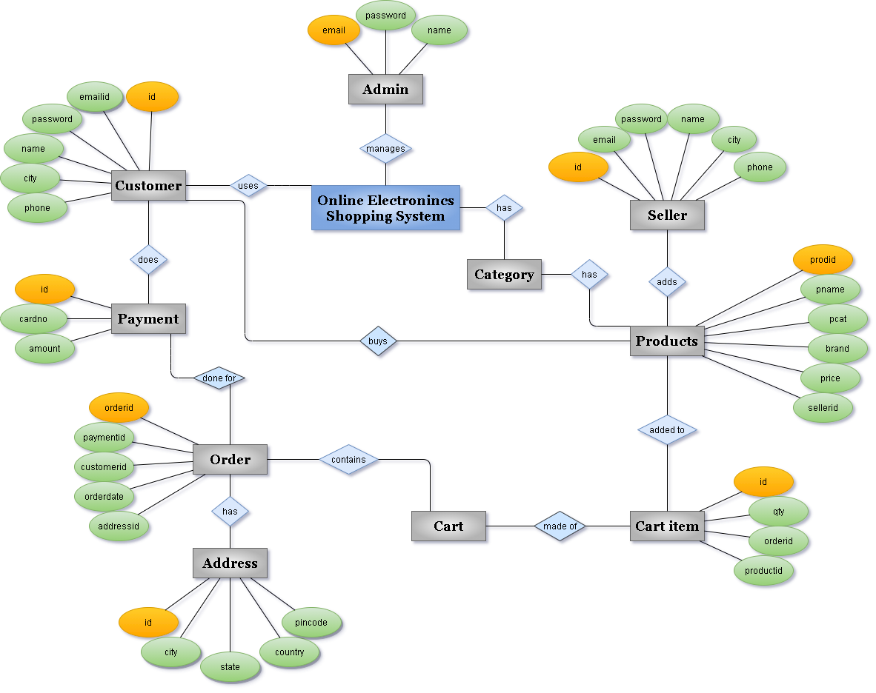
E R Diagram

Slide 8
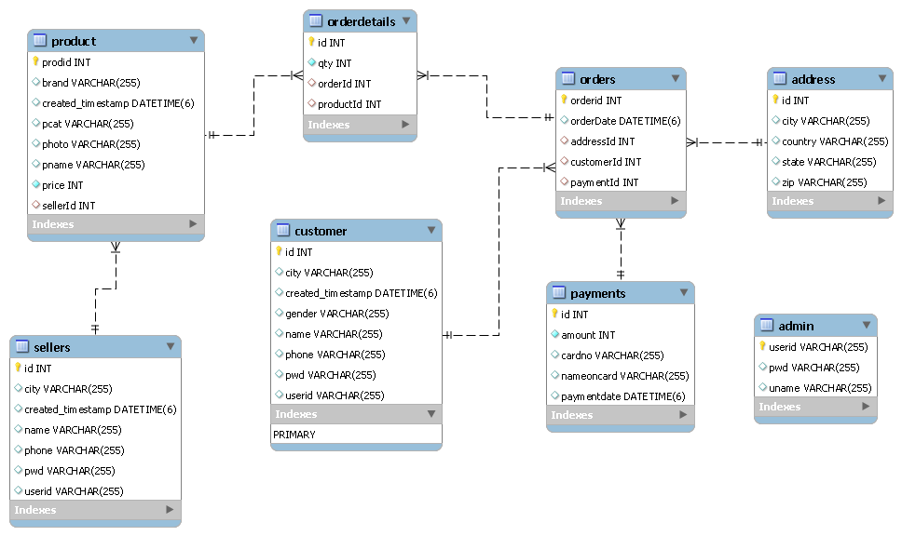
Class Diagram

Slide 9
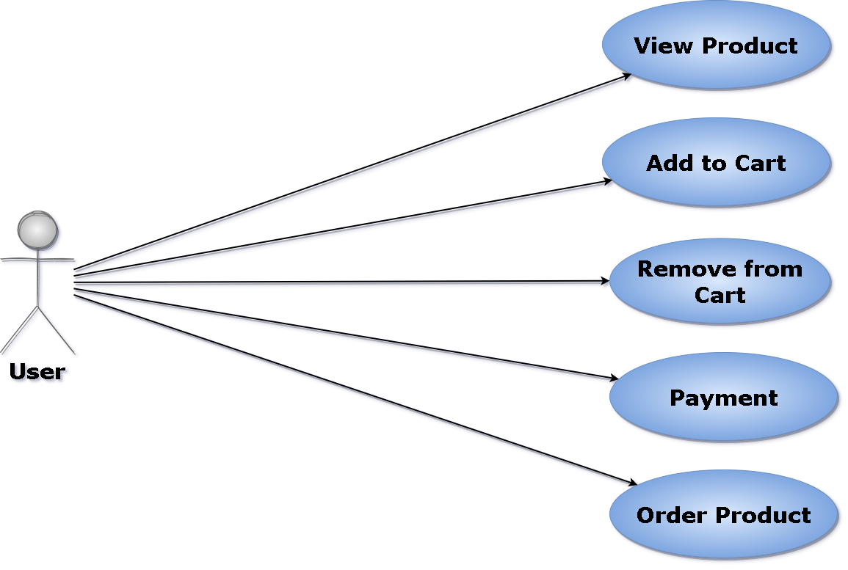
Use Case Diagrams (Customer)

Slide 10
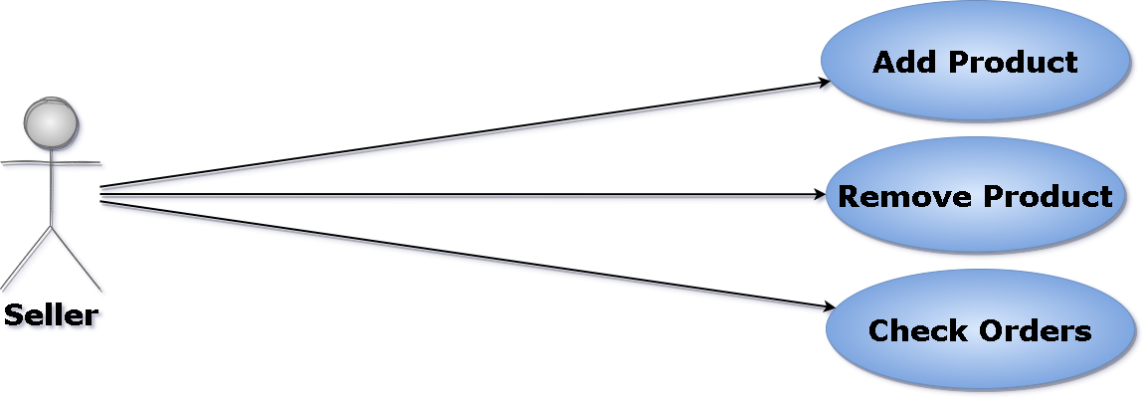
Use Case Diagram(Seller)

Slide 11
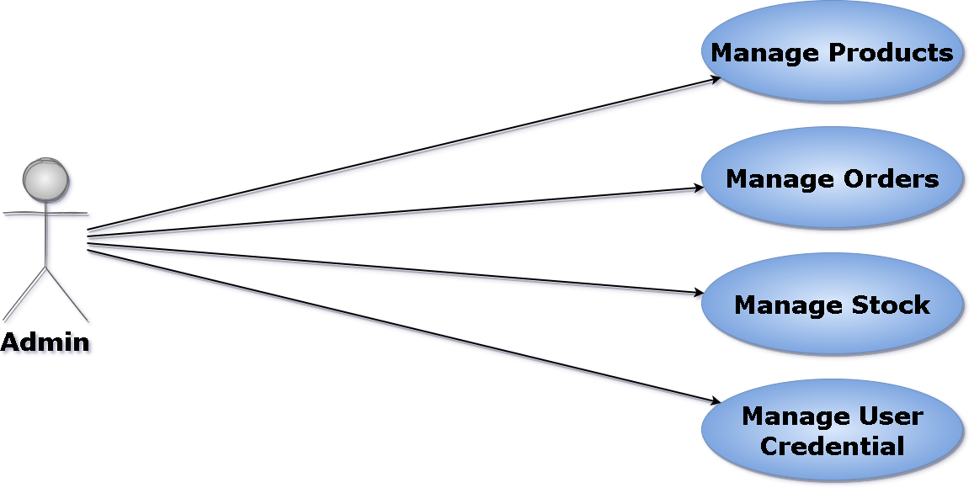
Use Case Diagram(Admin)

Slide 12
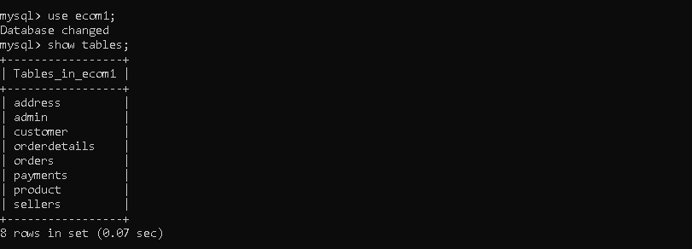
Database Tables Structures

Slide 13
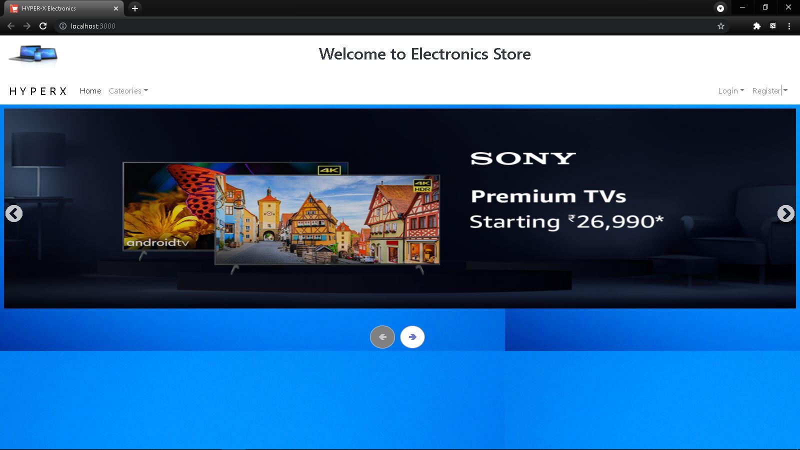
Screenshots of Project

Slide 14
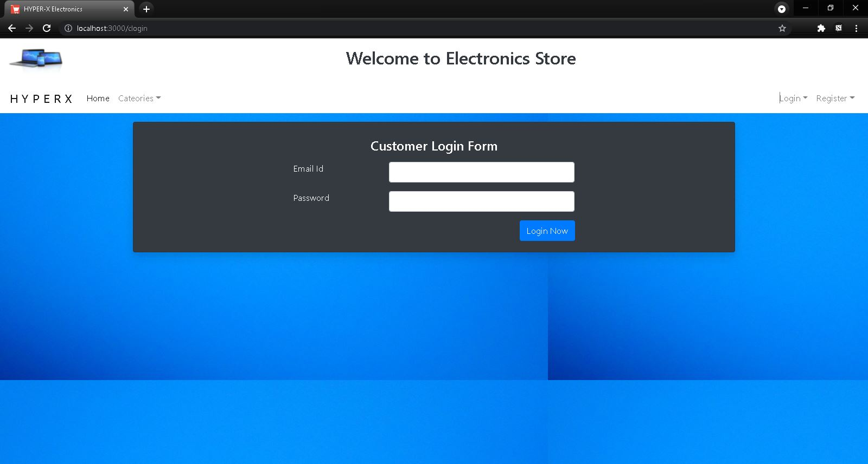

Slide 15
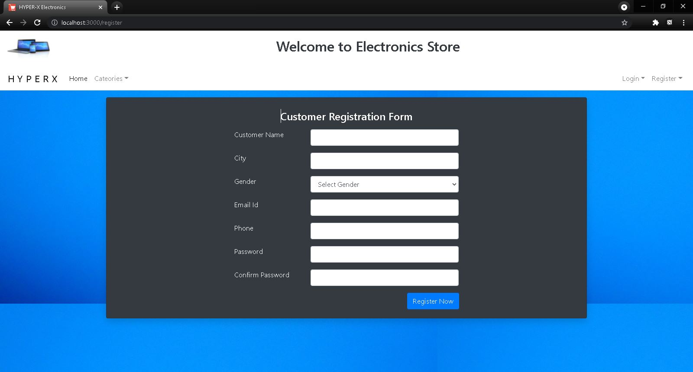

Slide 16
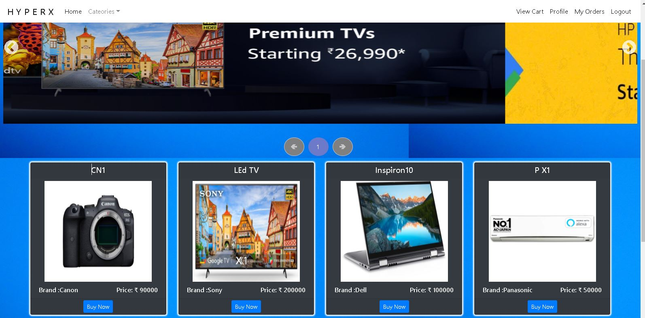

Slide 17
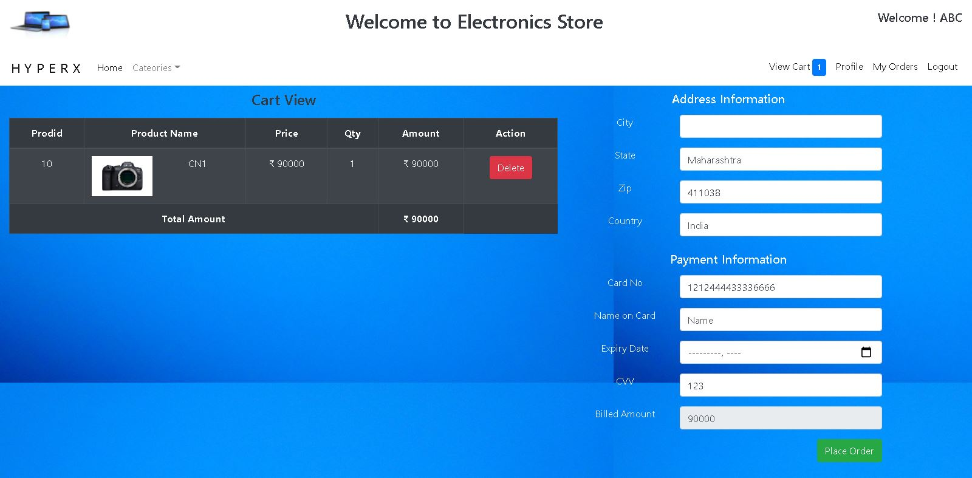

Slide 18
Future Scope
The Future Scope of the Project includes to provide a fully functional and genuine Payment Gateway System.
Also the future Scope includes order tracking and delivery status.

Slide 19
Conclusion
The main function of the project is to develop an e-commerce application which can be used to order the products online with the ease of ordering the products.
The System is capable to order the products and provides the user with the basic functionalities such as adding the product to the cart and deleting it from the cart.

Slide 20
References
www.google.com.
Wikipedia.com.
“Sample Ecommerce Website” https://www.croma.com/.
Java and Other Official Documentations

